Slide 1
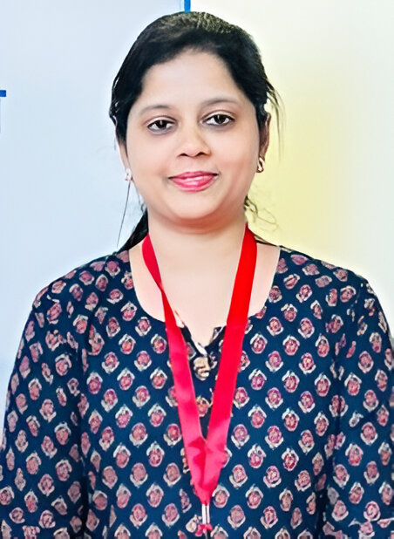

Our Team
Name
Kavita
Experience
Role
Project Consultant
Experienced IT professional with 9+ years in software development, IT consulting, and academic research. Adept in full-stack web development, algorithm design, and system architecture. Holds a Ph.D. in Computer Science with specialization in metaheuristic techniques for solving NP-Hard problems. Proven ability to deliver scalable, high-performance solutions for government and enterprise systems, with a strong focus on digital transformation and technical innovation.
Developed multiple digital governance platforms such as the SDG Dashboard, Novenmesh Portal, and Viksit Chhattisgarh Portal to support data-driven policy making.
Led technical development for portals like the Right of Way Portal, Rajeev Yuva Mitaan Club Scheme Portal, and CG-STATE Portal to enhance citizen service delivery.
Designed and maintained key e-Governance platforms including the e-Bill System and State Finance Commission Portal for public financial management.
Contributed to funded academic research projects, algorithm development, and optimization studies at NIT Raipur and as part of DST-SERB grants.
Qualification
Ph.D in Computer Application
Overall experience
9+ years
Sector focus
Software Development, Data Analytics
Relationships
State Government

